Slide 1
Summary presentation for senior leaders
In case of enquiries please contact GL Assessment by emailing info@gl-assessment.co.uk.
Copyright © 2019 GL Assessment Limited
GL Assessment is part of the GL Education Group
School: GEMS World Academy Dubai
Group: Unknown
Period of testing: 12/09/2019 – 04/03/2020
Level: G
No. of students: 108
Report generated on
Report generated on
11/09/2020
11/09/2020

Slide 2
CAT4 Summary presentation for senior leaders
What is the Cognitive Abilities Test Fourth Edition (CAT4)?
• Assesses developed abilities • Verbal Reasoning Battery – thinking with words • Quantitative (or Numerical) Reasoning Battery – thinking with numbers • Non-verbal Reasoning Battery – thinking with shapes • Spatial Ability Battery – thinking with shape and space
Copyright © 2019 GL Assessment Limited
Slide 2 of 20

Slide 3
CAT4 Summary presentation for senior leaders
Why use CAT4?
• Overview of performance of group of students • Comparison between groups of students • Identifying students at risk of underachievement • Monitoring ability profile of intakes • Benchmark for value added • Indicators for national tests and exams
Copyright © 2019 GL Assessment Limited
Slide 3 of 20

Slide 4
CAT4 Summary presentation for senior leaders
Group analysis (by battery)
The table below shows mean (average) scores for all students compared with those for the national sample.
Verbal mean SAS
Quantitative mean SAS
Non-verbal mean SAS
Spatial mean SAS
Overall mean SAS
National average
100.0
100.0
100.0
100.0
100.0
All students
102.0
108.0
110.1
112.0
108.2
90% confidence band
100.1–103.8
105.7–110.3
107.8–112.4
109.6–114.4
106.4–110.0
The table below shows the distribution of scores for all students compared with those of the national sample. The bar chart also presents this information on the following slide.
Description
Very low
Below average
Average
Above average
Very high
SAS bands
<74
74–81
82–88
89–96
97–103
104–111
112–118
119–126
>126
National average
4%
7%
12%
17%
20%
17%
12%
7%
4%
Verbal
1%
5%
3%
24%
24%
22%
15%
6%
1%
Quantitative
2%
2%
5%
13%
15%
18%
21%
16%
9%
Non-verbal
1%
1%
4%
9%
18%
28%
13%
10%
17%
Spatial
1%
3%
6%
6%
6%
19%
30%
15%
14%
Copyright © 2019 GL Assessment Limited
Slide 4 of 20

Slide 5
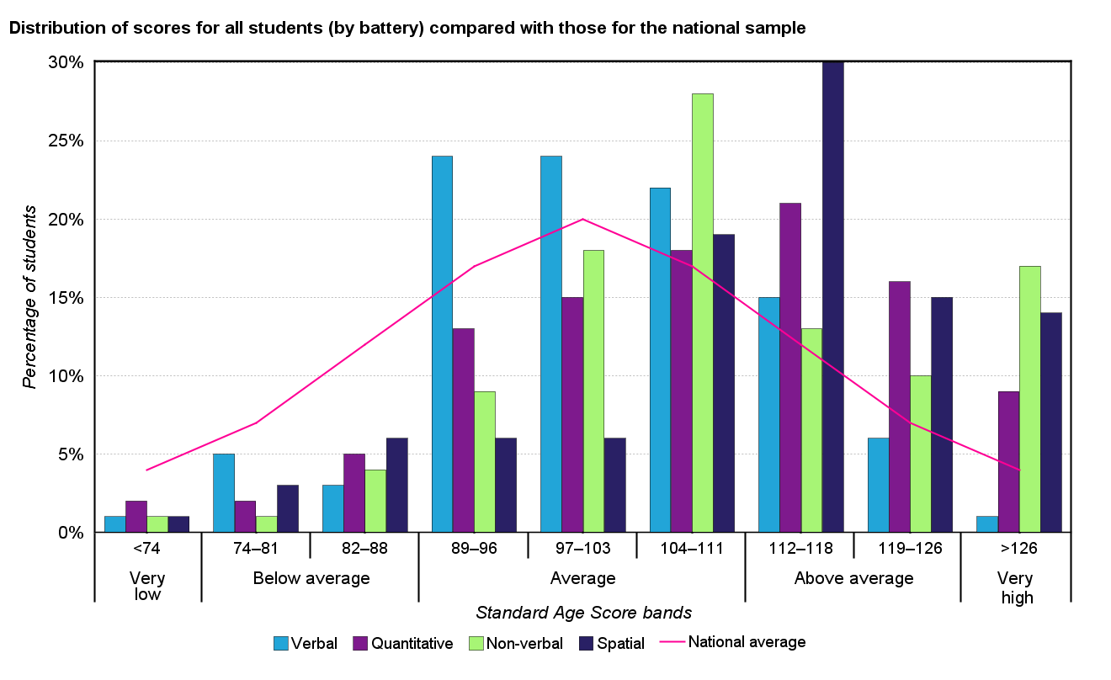
CAT4 Summary presentation for senior leaders
Group analysis (by battery)
Copyright © 2019 GL Assessment Limited
Slide 5 of 20

Slide 6
CAT4 Summary presentation for senior leaders
Group analysis (by gender)
The table below shows mean (average) scores for all students compared with those for the national sample.
No. of students
Verbal mean SAS
Quantitative mean SAS
Non-verbal mean SAS
Spatial mean SAS
Overall mean SAS
National average
-
100.0
100.0
100.0
100.0
100.0
All students
108
102.0
108.0
110.1
112.0
108.2
Males
52
100.3
112.3
108.0
111.3
108.1
Females
56
103.5
104.0
112.1
112.6
108.2
Copyright © 2019 GL Assessment Limited
Slide 6 of 20

Slide 7
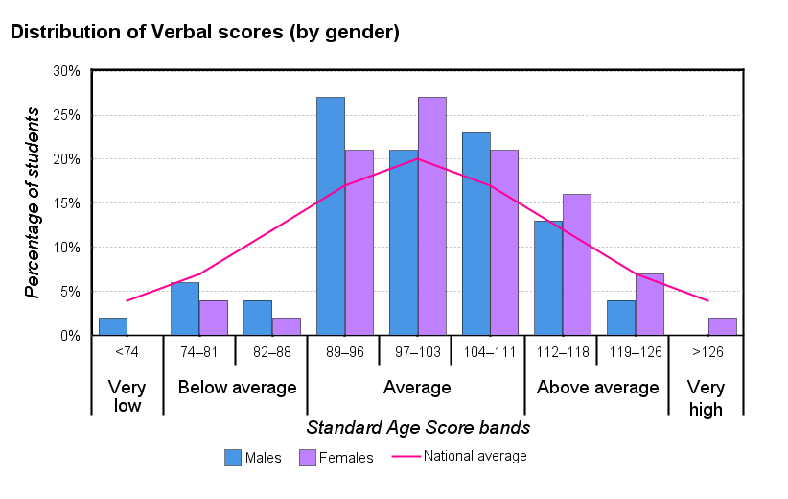
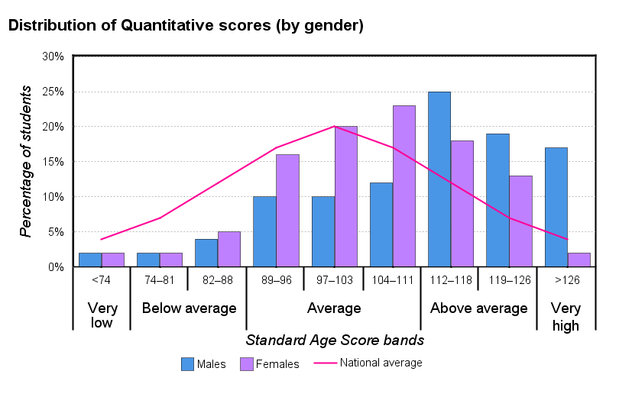
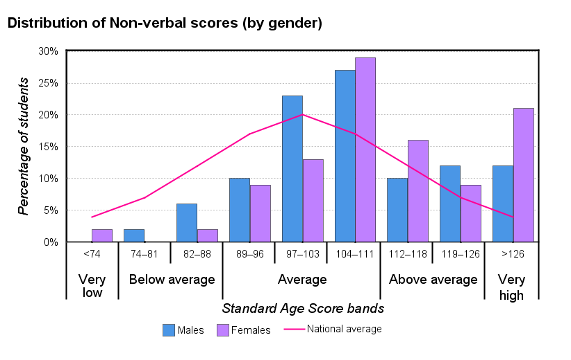
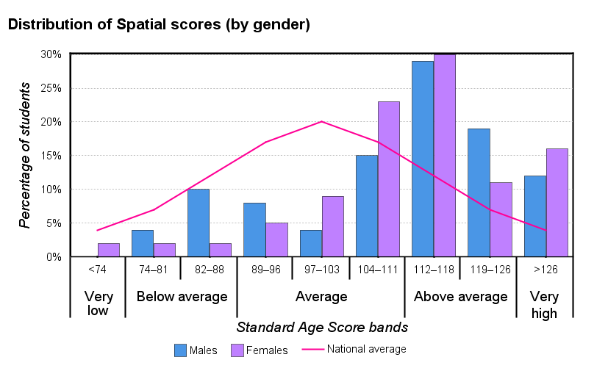
CAT4 Summary presentation for senior leaders
Copyright © 2019 GL Assessment Limited
Slide 7 of 20

Slide 8
CAT4 Summary presentation for senior leaders
Group analysis (by ethnicity)
The table below shows mean (average) scores for all students compared with those for the national sample.
No. of students
Verbal mean SAS
Quantitative mean SAS
Non-verbal mean SAS
Spatial mean SAS
Overall mean SAS
National average
-
100.0
100.0
100.0
100.0
100.0
All students
108
102.0
108.0
110.1
112.0
108.2
Indian
13
101.6
104.5
103.4
106.1
104.0
Turkish
7
102.4
114.4
110.1
111.4
109.9
Australian
5
110.6
113.0
112.8
121.2
114.8
Emirati
5
100.6
101.0
115.8
112.6
107.6
German
5
114.2
114.8
125.2
117.0
117.8
Pakistani
5
101.0
90.4
100.2
91.0
95.8
Belgian
4
100.8
111.5
112.8
112.8
109.5
British
4
114.5
111.0
112.3
121.0
114.8
Dutch
4
105.8
108.3
111.8
112.5
109.5
Italian
4
87.5
86.8
92.5
93.0
90.0
Other
52
100.2
110.4
111.3
114.8
109.3
Copyright © 2019 GL Assessment Limited
Slide 8 of 20

Slide 9
CAT4 Summary presentation for senior leaders
Group analysis (by special educational need)
The table below shows mean (average) scores for all students compared with those for the national sample.
No. of students
Verbal mean SAS
Quantitative mean SAS
Non-verbal mean SAS
Spatial mean SAS
Overall mean SAS
National average
-
100.0
100.0
100.0
100.0
100.0
All students
108
102.0
108.0
110.1
112.0
108.2
No
99
102.9
108.9
110.8
112.6
108.9
Yes
9
91.6
98.0
102.4
105.6
99.7
Copyright © 2019 GL Assessment Limited
Slide 9 of 20

Slide 10
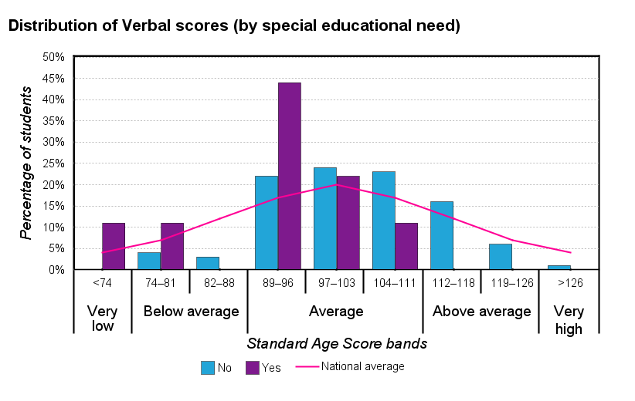
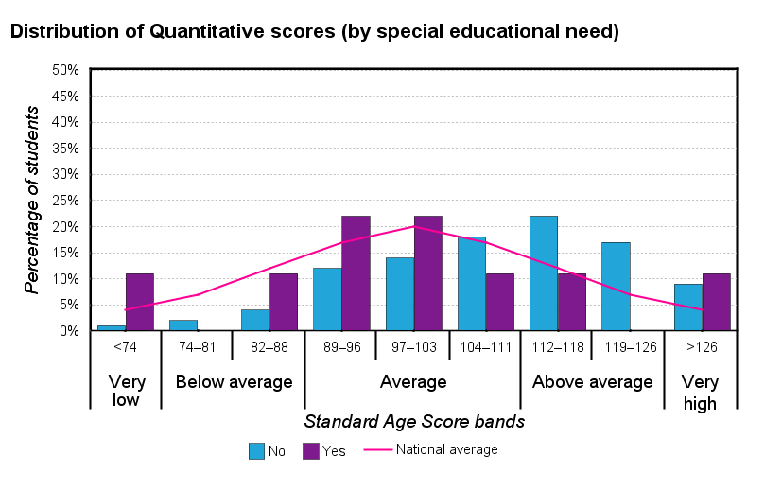
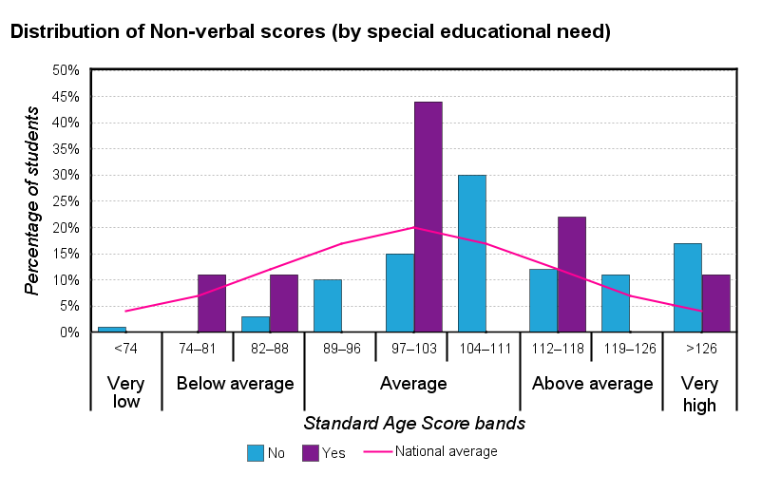
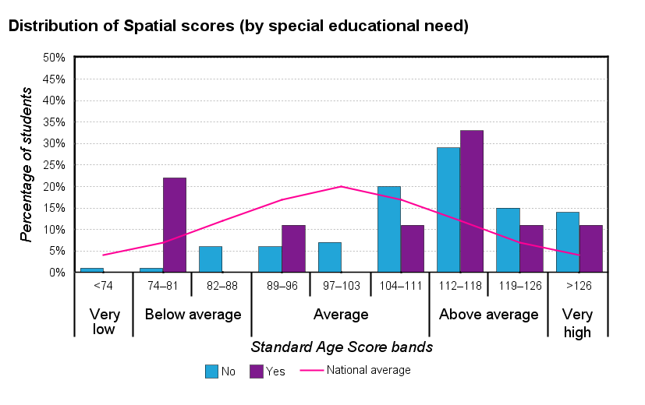
CAT4 Summary presentation for senior leaders
Copyright © 2019 GL Assessment Limited
Slide 10 of 20

Slide 11
CAT4 Summary presentation for senior leaders
Group analysis (by English as an additional language)
The table below shows mean (average) scores for all students compared with those for the national sample.
No. of students
Verbal mean SAS
Quantitative mean SAS
Non-verbal mean SAS
Spatial mean SAS
Overall mean SAS
National average
-
100.0
100.0
100.0
100.0
100.0
All students
108
102.0
108.0
110.1
112.0
108.2
No
102
102.7
108.3
110.3
112.1
108.5
Yes
6
89.5
102.7
107.2
109.7
102.3
Copyright © 2019 GL Assessment Limited
Slide 11 of 20

Slide 12
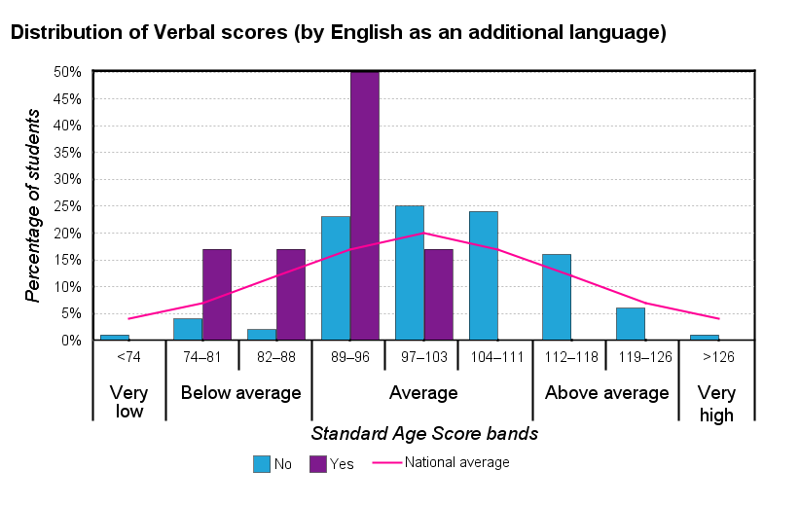
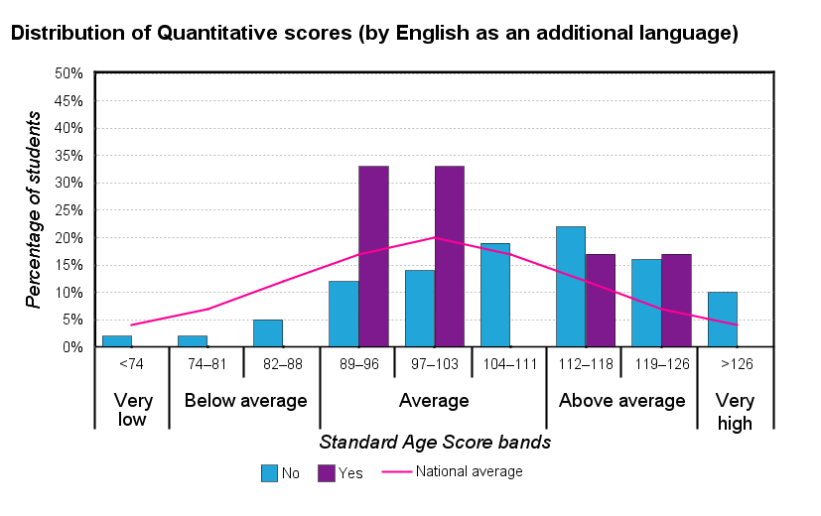
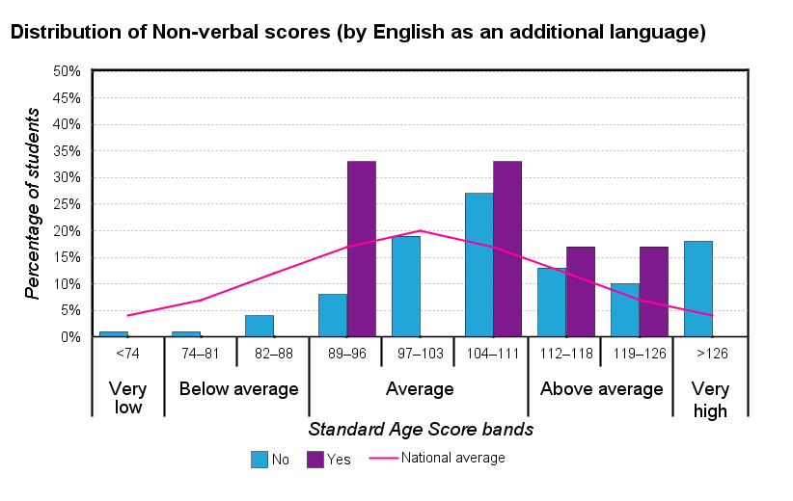
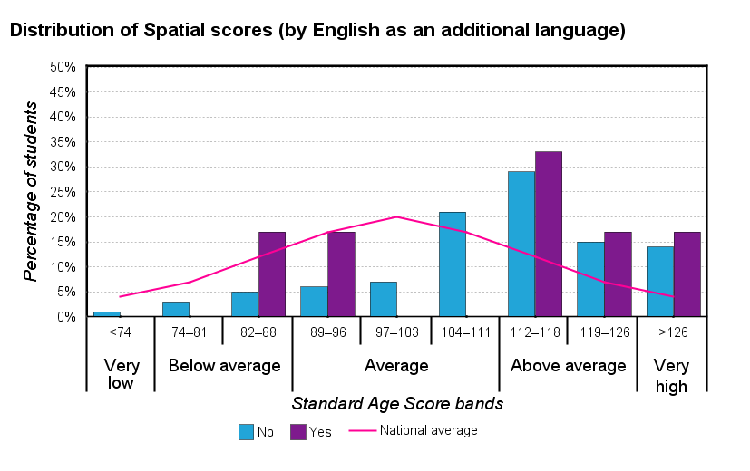
CAT4 Summary presentation for senior leaders
Copyright © 2019 GL Assessment Limited
Slide 12 of 20

Slide 13
CAT4 Summary presentation for senior leaders
Group analysis (by Custom 1)
The table below shows mean (average) scores for all students compared with those for the national sample.
No. of students
Verbal mean SAS
Quantitative mean SAS
Non-verbal mean SAS
Spatial mean SAS
Overall mean SAS
National average
-
100.0
100.0
100.0
100.0
100.0
All students
108
102.0
108.0
110.1
112.0
108.2
01/09/2019
39
102.2
106.3
110.9
112.6
108.2
02/09/2018
8
98.6
100.1
109.1
107.5
103.9
30/08/2015
7
103.3
106.0
107.9
106.3
106.0
01/09/2013
4
114.0
117.5
120.0
124.3
119.3
01/09/2014
3
109.0
106.3
114.0
119.7
112.3
26/09/2018
3
86.0
104.0
110.3
116.3
104.3
28/08/2016
3
110.3
110.0
108.7
112.0
110.0
02/09/2012
2
110.0
121.0
111.0
116.0
114.5
02/09/2019
2
93.5
111.5
99.0
104.5
102.5
06/01/2019
2
107.0
113.0
113.5
105.5
110.0
Other
35
100.6
110.2
108.9
111.6
108.0
Copyright © 2019 GL Assessment Limited
Slide 13 of 20

Slide 14
CAT4 Summary presentation for senior leaders
Group analysis (by Custom 2)
The table below shows mean (average) scores for all students compared with those for the national sample.
No. of students
Verbal mean SAS
Quantitative mean SAS
Non-verbal mean SAS
Spatial mean SAS
Overall mean SAS
National average
-
100.0
100.0
100.0
100.0
100.0
All students
108
102.0
108.0
110.1
112.0
108.2
Other
103
102.0
108.4
109.8
112.0
108.2
Emirati
5
100.6
101.0
115.8
112.6
107.6
Copyright © 2019 GL Assessment Limited
Slide 14 of 20

Slide 15
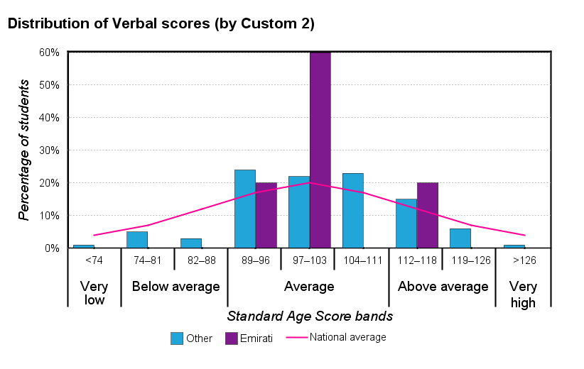
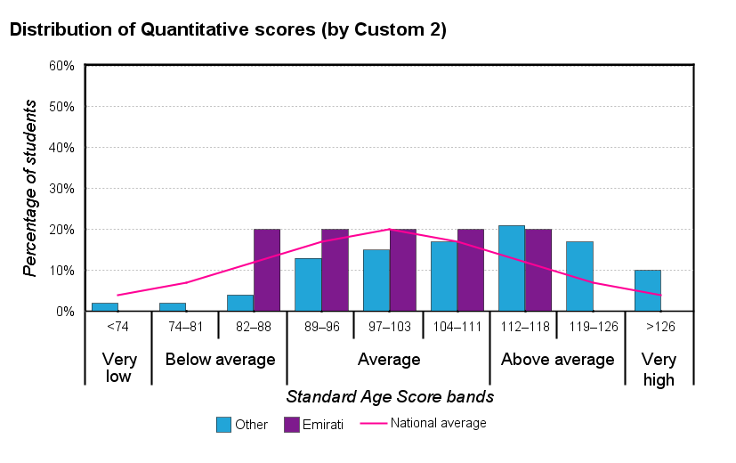
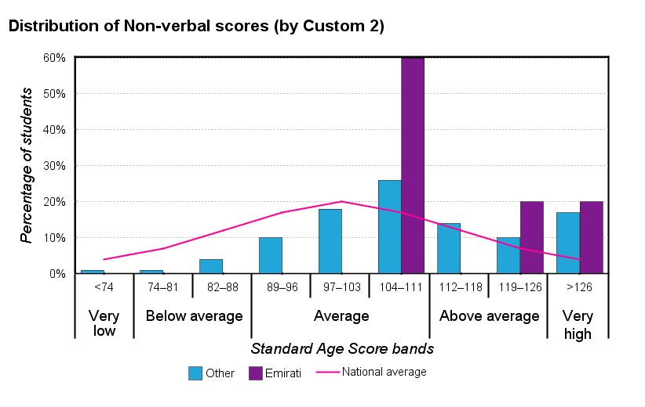
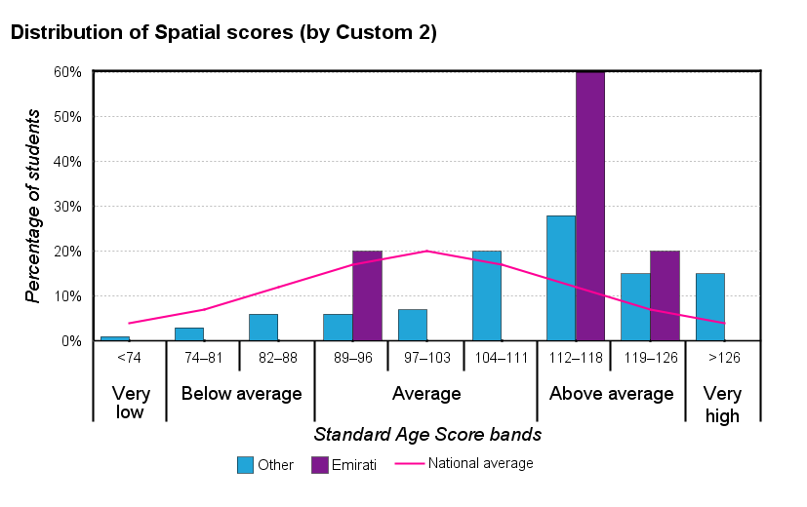
CAT4 Summary presentation for senior leaders
Copyright © 2019 GL Assessment Limited
Slide 15 of 20

Slide 16
CAT4 Summary presentation for senior leaders
Student profiles
The analysis of CAT4 scores allows all students to be assigned a profile; that is, they are assigned to one of seven broad descriptions of their preferences for learning. The Verbal Reasoning and Spatial Ability Batteries form the basis of this analysis and the profiles are expressed as a mild, moderate or extreme bias for verbal or spatial learning or where no bias is discernable (that is, when scores on both batteries are similar), as an even profile.
National
Group
%
%
No. of students
Extreme verbal bias
2%
1%
1
Moderate verbal bias
4%
2%
2
Mild verbal bias
11%
4%
4
No bias or even profile
66%
51%
55
Mild spatial bias
11%
16%
17
Moderate spatial bias
4%
14%
15
Extreme spatial bias
2%
13%
14
Copyright © 2019 GL Assessment Limited
Slide 16 of 20

Slide 17
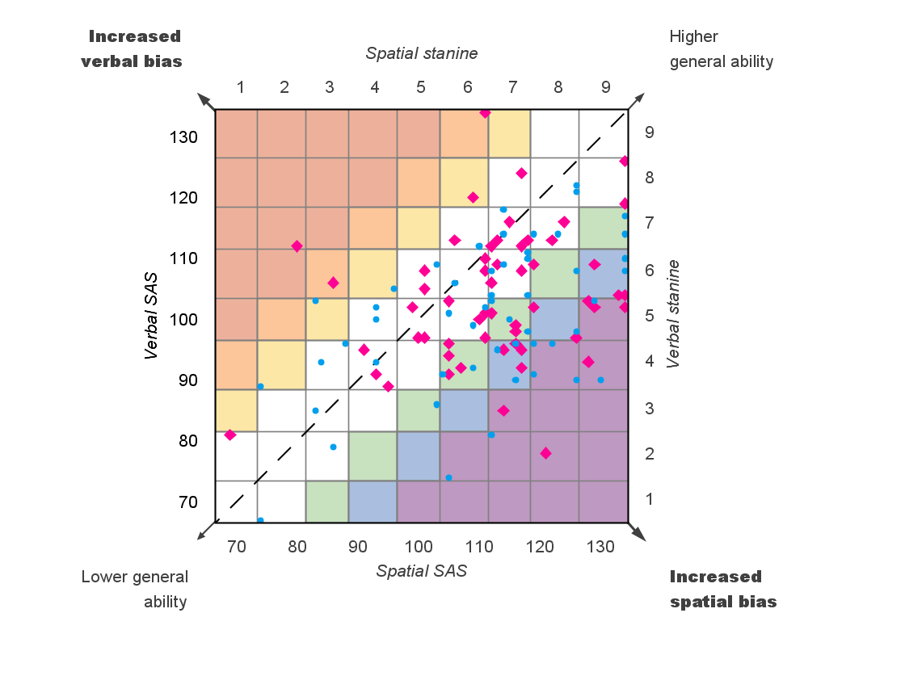
CAT4 Summary presentation for senior leaders
Distribution of profiles within the group
Extreme verbal bias
Moderate verbal bias
Mild verbal bias
No bias
Mild spatial bias
Moderate spatial bias
Extreme spatial bias
•
Males
Females
Copyright © 2019 GL Assessment Limited
Slide 17 of 20

Slide 18
CAT4 Summary presentation for senior leaders
Other reports available
• CAT4 Summary report for senior leaders • CAT4 Group report for teachers • CAT4 Individual student report for teachers • CAT4 Individual report for parents • CAT4 Individual report for students • CAT4 Excel report • CAT4 Cluster report
Copyright © 2019 GL Assessment Limited
Slide 18 of 20

Slide 19
CAT4 Summary presentation for senior leaders
How to make best use of your CAT4 data
•
Group reports for teachers and Summary reports for senior leaders can: – inform decision making about curriculum and resources – provide a benchmark for monitoring and assessing value added.
•
Individual student reports for teachers should be shared with each student and form the basis, with other data, for: – setting targets – monitoring progress – adapting learning to suit the student's preferences.
•
Individual reports for students can be shared with key members of staff to ensure that: – teaching is appropriate to a student's learning preferences – support or challenge is appropriate to need.
Copyright © 2019 GL Assessment Limited
Page 19 of 20

Slide 20
CAT4 Summary presentation for senior leaders
How to make best use of your CAT4 data
•
Individual reports for students provide each student with a copy of his or her results to take away.
•
Individual reports for parents provide the parent or carer with a copy of their child's results to help them understand the process and how they can offer support at home.
•
Data about students' abilities based on CAT4 can be used very effectively with other information such as that provided by attainment tests and teacher assessment to help set targets for learning and public examinations.
Copyright © 2019 GL Assessment Limited
Page 20 of 20

