Slide 1
Summary presentation for senior leaders
In case of enquiries please contact GL Assessment by emailing info@gl-assessment.co.uk.
Copyright © 2014 GL Assessment Limited.
GL Assessment is part of the GL Education Group.
School: GEMS World Academy Dubai
Group: Unknown
Period of testing: 26/09/2016 – 28/09/2016
Level: G
No. of students: 135
Report generated on
Report generated on
01/10/2016
01/10/2016

Slide 2
CAT4 Summary presentation for senior leaders
What is the Cognitive Abilities Test Fourth Edition (CAT4)?
• Assesses developed abilities • Verbal Reasoning Battery – thinking with words • Quantitative (or Numerical) Reasoning Battery – thinking with numbers • Non-verbal Reasoning Battery – thinking with shapes • Spatial Ability Battery – thinking with shape and space
Copyright © 2014 GL Assessment Limited
Slide 2 of 20

Slide 3
CAT4 Summary presentation for senior leaders
Why use CAT4?
• Overview of performance of group of students • Comparison between groups of students • Identifying students at risk of underachievement • Monitoring ability profile of intakes • Benchmark for value added • Indicators for national tests and exams
Copyright © 2014 GL Assessment Limited
Slide 3 of 20

Slide 4
CAT4 Summary presentation for senior leaders
Group analysis (by battery)
The table below shows mean (average) scores for all students compared with those for the national sample.
Verbal mean SAS
Quantitative mean SAS
Non-verbal mean SAS
Spatial mean SAS
Overall mean SAS
National average
100.0
100.0
100.0
100.0
100.0
All students
102.9
109.7
105.4
105.2
105.5
90% confidence band
101.0–104.8
107.3–112.2
103.2–107.6
102.7–107.6
103.7–107.3
The table below shows the distribution of scores for all students compared with those of the national sample. The bar chart also presents this information on the following slide.
Description
Very low
Below average
Average
Above average
Very high
SAS bands
<74
74–81
82–88
89–96
97–103
104–111
112–118
119–126
>126
National average
4%
7%
12%
17%
20%
17%
12%
7%
4%
Verbal
1%
4%
7%
21%
17%
22%
15%
7%
4%
Quantitative
2%
3%
3%
12%
12%
21%
21%
12%
14%
Non-verbal
1%
4%
8%
19%
15%
21%
12%
10%
10%
Spatial
2%
4%
7%
19%
15%
17%
12%
17%
7%
Copyright © 2014 GL Assessment Limited
Slide 4 of 20

Slide 5
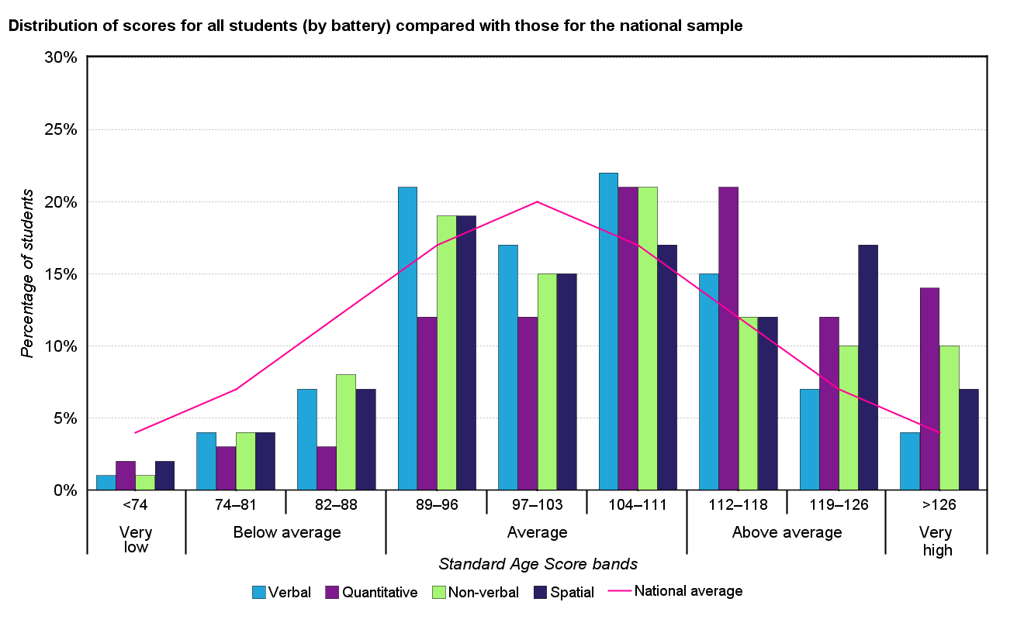
CAT4 Summary presentation for senior leaders
Group analysis (by battery)
Copyright © 2014 GL Assessment Limited
Slide 5 of 20

Slide 6
CAT4 Summary presentation for senior leaders
Group analysis (by gender)
The table below shows mean (average) scores for all students compared with those for the national sample.
No. of students
Verbal mean SAS
Quantitative mean SAS
Non-verbal mean SAS
Spatial mean SAS
Overall mean SAS
National average
-
100.0
100.0
100.0
100.0
100.0
All students
135
102.9
109.7
105.4
105.2
105.5
Males
74
103.5
113.8
106.4
105.8
107.0
Females
61
102.1
105.1
104.2
104.5
103.8
Copyright © 2014 GL Assessment Limited
Slide 6 of 20

Slide 7
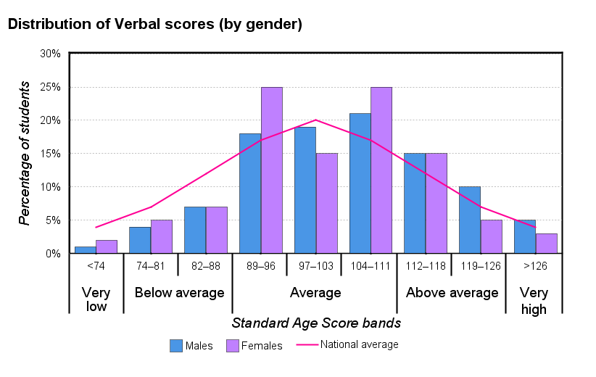
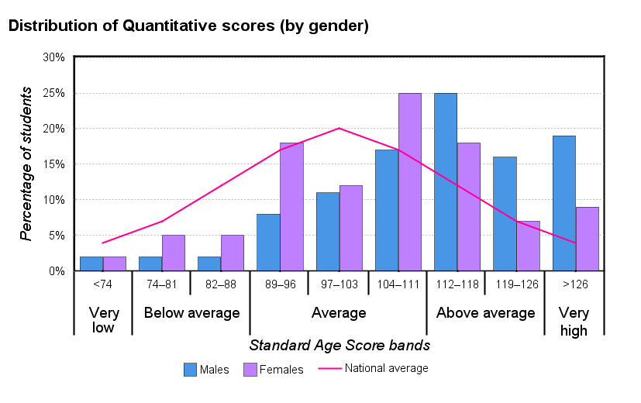
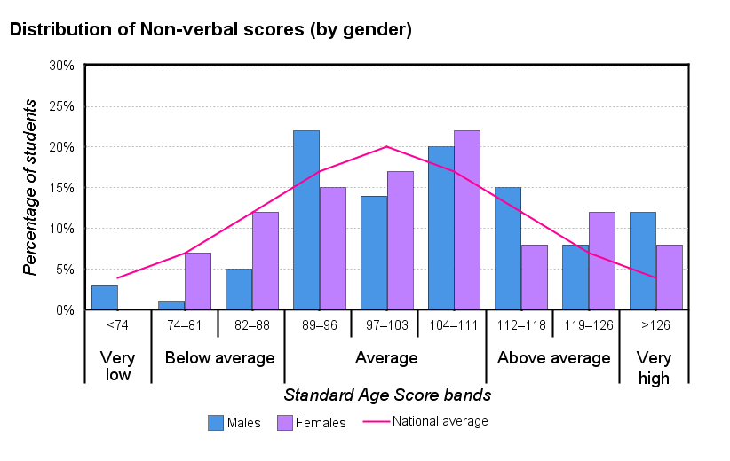
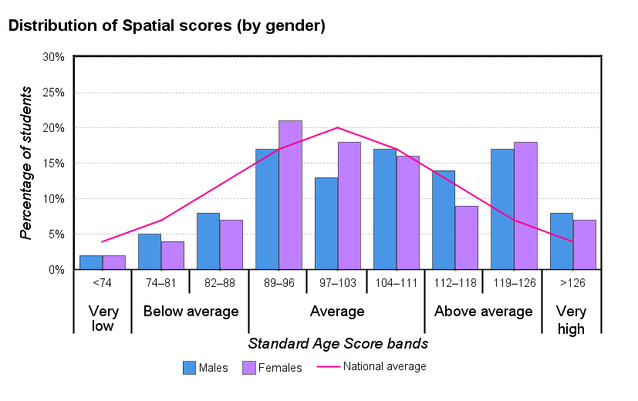
CAT4 Summary presentation for senior leaders
Copyright © 2014 GL Assessment Limited
Slide 7 of 20

Slide 8
CAT4 Summary presentation for senior leaders
Group analysis (by ethnicity)
The table below shows mean (average) scores for all students compared with those for the national sample.
No. of students
Verbal mean SAS
Quantitative mean SAS
Non-verbal mean SAS
Spatial mean SAS
Overall mean SAS
National average
-
100.0
100.0
100.0
100.0
100.0
All students
135
102.9
109.7
105.4
105.2
105.5
Indian
14
105.5
112.5
106.4
106.8
107.6
South Korea
12
100.3
121.8
114.8
119.3
114.1
American
8
109.4
104.4
104.3
94.1
104.0
British
7
105.9
104.9
101.0
100.0
103.1
Canadian
7
102.6
112.5
97.3
95.7
101.0
Dutch
7
92.0
106.5
110.6
106.8
103.4
Danish
5
105.2
105.0
98.8
93.3
99.4
Italian
5
98.2
111.7
100.4
114.0
102.0
Russian
5
98.8
107.4
97.2
106.0
102.4
Saudi Arabian
5
92.8
92.8
90.4
90.0
91.8
Other
60
104.3
109.8
107.0
106.3
106.8
Copyright © 2014 GL Assessment Limited
Slide 8 of 20

Slide 9
CAT4 Summary presentation for senior leaders
Group analysis (by special educational need)
The table below shows mean (average) scores for all students compared with those for the national sample.
No. of students
Verbal mean SAS
Quantitative mean SAS
Non-verbal mean SAS
Spatial mean SAS
Overall mean SAS
National average
-
100.0
100.0
100.0
100.0
100.0
All students
135
102.9
109.7
105.4
105.2
105.5
No
127
103.1
110.4
105.5
105.4
105.8
Yes
8
99.9
99.3
103.5
101.6
100.6
Copyright © 2014 GL Assessment Limited
Slide 9 of 20

Slide 10
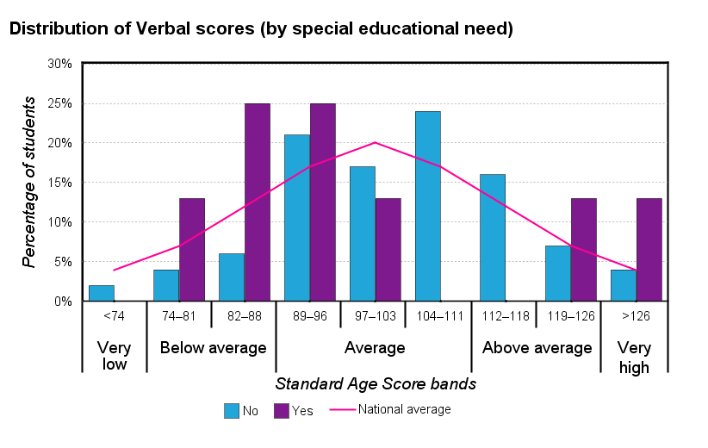
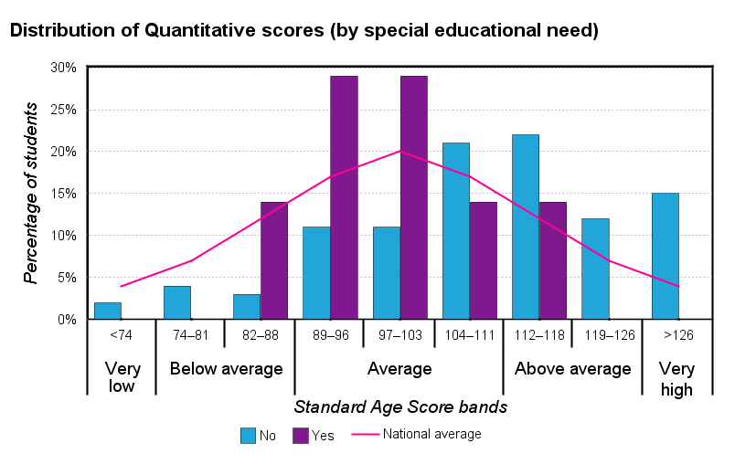
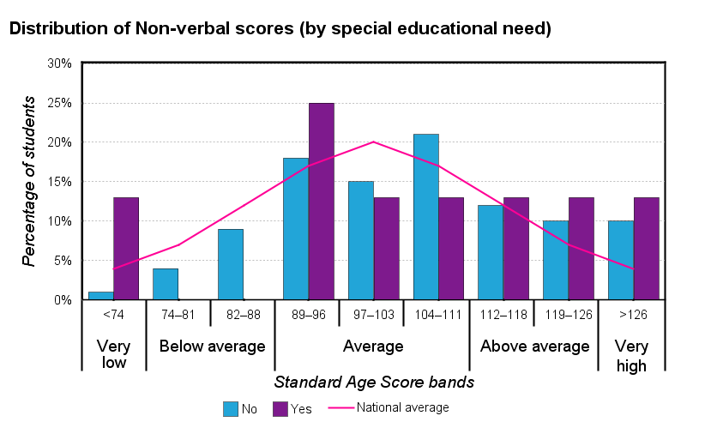
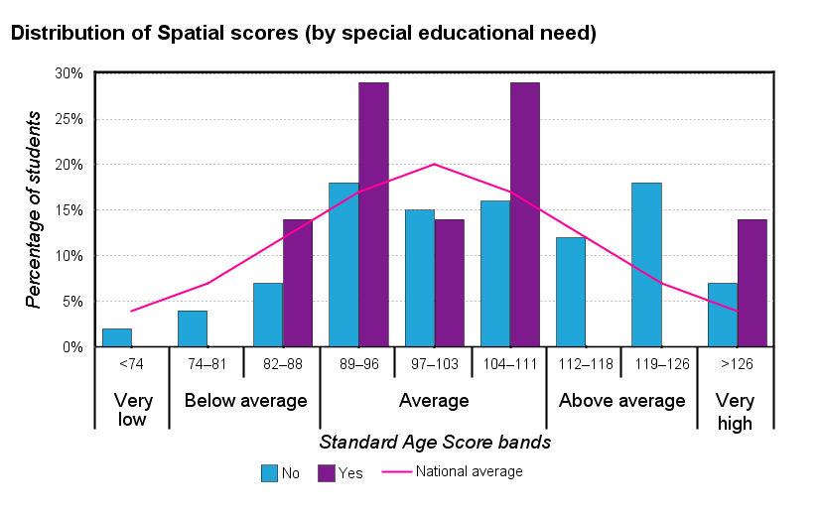
CAT4 Summary presentation for senior leaders
Copyright © 2014 GL Assessment Limited
Slide 10 of 20

Slide 11
CAT4 Summary presentation for senior leaders
Group analysis (by English as an additional language)
The table below shows mean (average) scores for all students compared with those for the national sample.
No. of students
Verbal mean SAS
Quantitative mean SAS
Non-verbal mean SAS
Spatial mean SAS
Overall mean SAS
National average
-
100.0
100.0
100.0
100.0
100.0
All students
135
102.9
109.7
105.4
105.2
105.5
No
135
102.9
109.7
105.4
105.2
105.5
Copyright © 2014 GL Assessment Limited
Slide 11 of 20

Slide 12
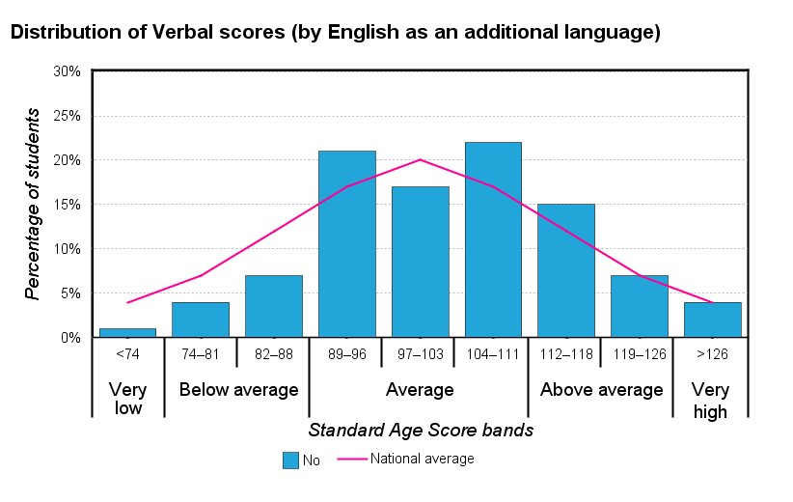
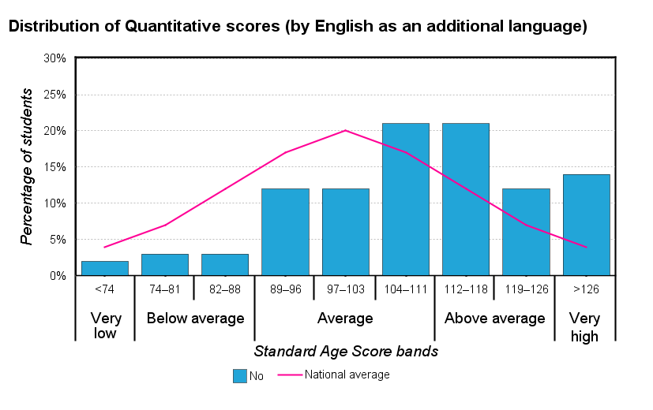
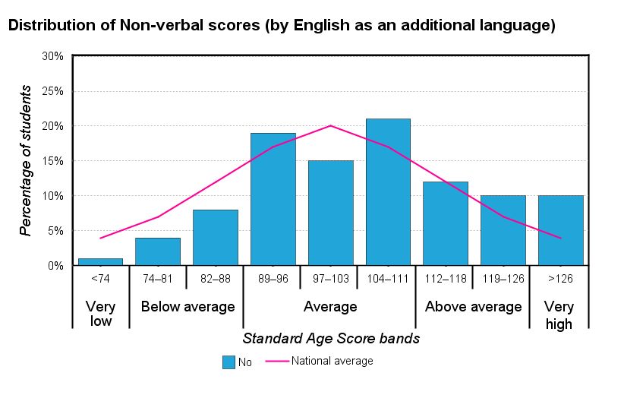
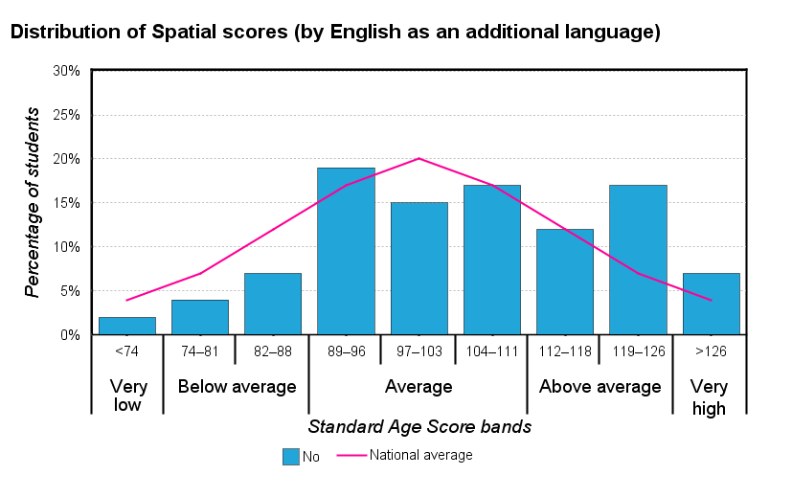
CAT4 Summary presentation for senior leaders
Copyright © 2014 GL Assessment Limited
Slide 12 of 20

Slide 13
CAT4 Summary presentation for senior leaders
Group analysis (by Custom 2)
The table below shows mean (average) scores for all students compared with those for the national sample.
No. of students
Verbal mean SAS
Quantitative mean SAS
Non-verbal mean SAS
Spatial mean SAS
Overall mean SAS
National average
-
100.0
100.0
100.0
100.0
100.0
All students
135
102.9
109.7
105.4
105.2
105.5
Other
133
103.1
110.1
105.6
105.4
105.8
Emirati
2
85.5
88.5
89.0
90.0
88.5
Copyright © 2014 GL Assessment Limited
Slide 13 of 20

Slide 14
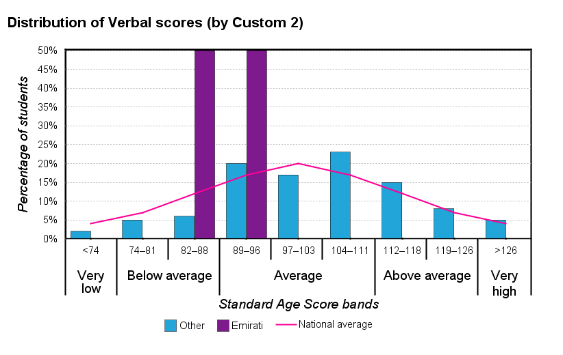
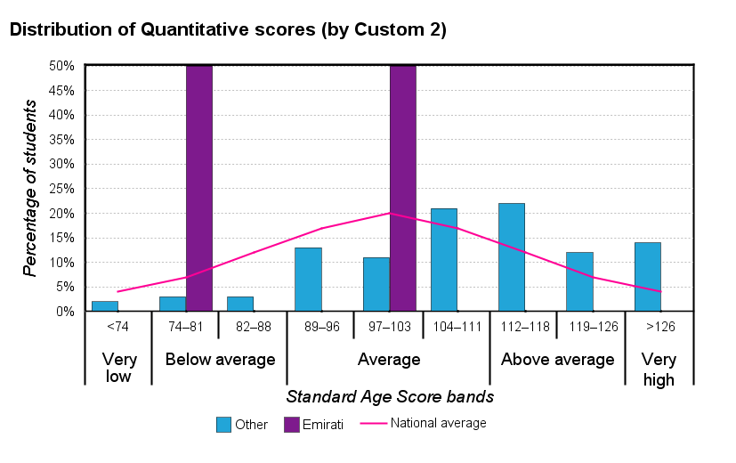
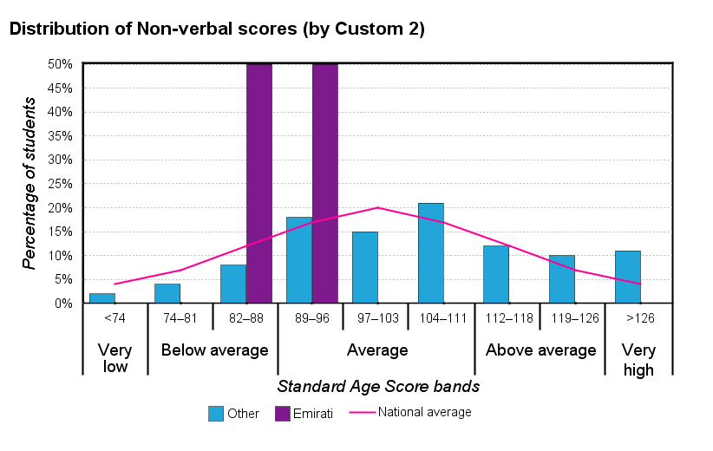
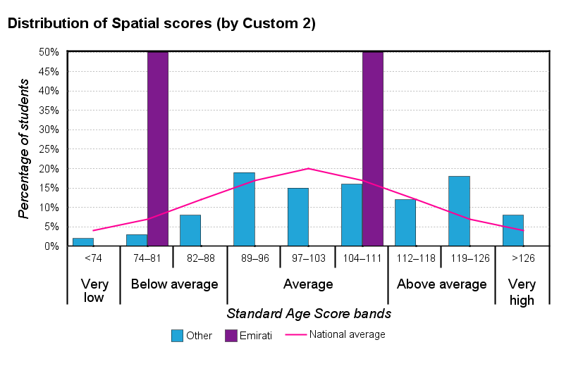
CAT4 Summary presentation for senior leaders
Copyright © 2014 GL Assessment Limited
Slide 14 of 20

Slide 15
CAT4 Summary presentation for senior leaders
Student profiles
The analysis of CAT4 scores allows all students to be assigned a profile; that is, they are assigned to one of seven broad descriptions of their preferences for learning. The Verbal Reasoning and Spatial Ability Batteries form the basis of this analysis and the profiles are expressed as a mild, moderate or extreme bias for verbal or spatial learning or where no bias is discernable (that is, when scores on both batteries are similar), as an even profile.
National
Group
%
%
No. of students
Extreme verbal bias
2%
3%
4
Moderate verbal bias
4%
6%
7
Mild verbal bias
11%
8%
10
No bias or even profile
66%
55%
67
Mild spatial bias
11%
12%
15
Moderate spatial bias
4%
10%
12
Extreme spatial bias
2%
5%
6
Copyright © 2014 GL Assessment Limited
Slide 15 of 20

Slide 16
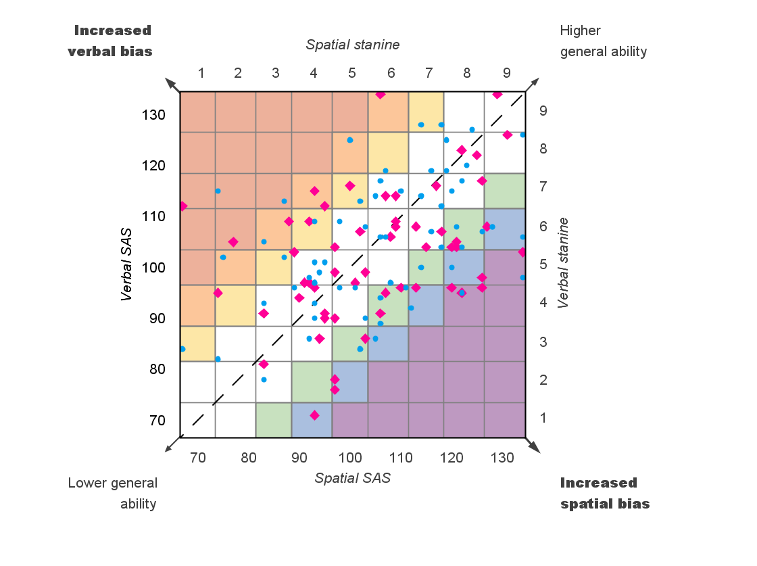
CAT4 Summary presentation for senior leaders
Distribution of profiles within the group
Extreme verbal bias
Moderate verbal bias
Mild verbal bias
No bias
Mild spatial bias
Moderate spatial bias
Extreme spatial bias
•
Males
Females
Copyright © 2014 GL Assessment Limited
Slide 16 of 20

Slide 17
CAT4 Summary presentation for senior leaders
GCSE indicators
There has always been a significant and positive correlation (that is, a link which is supported by statistical data) between students' scores on reasoning tests such as CAT4 and performance in national tests and examinations. CAT4, which provides a range of indicators of future attainment, demonstrates what can be achieved because the test has become established as a good predictor of subsequent attainment.
Summary GCSE indicators
All students
Males
Females
Percentage of students expected to achieve:
5+ A*–C GCSEs including English and maths
69%
72%
66%
5+ A*–C GCSEs
77%
80%
74%
5+ A*–G GCSEs
97%
97%
97%
Average point score
399.7
409.7
387.4
Average point score (best 8)
337.5
343.7
330.0
Number of students
135
74
61
Likely distribution of GCSE grades
Copyright © 2014 GL Assessment Limited
Slide 17 of 20

Slide 18
CAT4 Summary presentation for senior leaders
Other reports available
• CAT4 Summary report for senior leaders • CAT4 Group report for teachers • CAT4 Individual student report for teachers • CAT4 Individual report for parents • CAT4 Individual report for students • CAT4 Excel report • CAT4 Cluster report
Copyright © 2014 GL Assessment Limited
Slide 18 of 20

Slide 19
CAT4 Summary presentation for senior leaders
How to make best use of your CAT4 data
•
Group reports for teachers and Summary reports for senior leaders can: – inform decision making about curriculum and resources – provide a benchmark for monitoring and assessing value added.
•
Individual student reports for teachers should be shared with each student and form the basis, with other data, for: – setting targets – monitoring progress – adapting learning to suit the student's preferences.
•
Individual reports for students can be shared with key members of staff to ensure that: – teaching is appropriate to a student's learning preferences – support or challenge is appropriate to need.
Copyright © 2014 GL Assessment Limited
Slide 19 of 20

Slide 20
CAT4 Summary presentation for senior leaders
How to make best use of your CAT4 data
•
Individual reports for students provide each student with a copy of his or her results to take away.
•
Individual reports for parents provide the parent or carer with a copy of their child's results to help them understand the process and how they can offer support at home.
•
Data about students' abilities based on CAT4 can be used very effectively with other information such as that provided by attainment tests and teacher assessment to help set targets for learning and public examinations.
Copyright © 2014 GL Assessment Limited
Slide 20 of 20

